Slide 1
Cloud Essentials 101
NA Partner Channels – IBM Cloud
Technical Evangelism Team
Notes:
Welcome everyone to the Cloud Essentials overview session!

Slide 2
Building a Cognitive Chatbot
Overview and Hands-on workshop
Chris Tyler
Technical Evangelists
January 31, 2018
Notes:
Good {“Morning”, “Afternoon”, “Evening”}
Welcome to our session today on Building a Watson Chatbot.
My name is {{message.yourname}} and I’m excited that you’re here today.
Let’s get started.

Slide 3
Building a Cognitive Chatbot
Overview and Hands-on workshop
Chris Tyler
Technical Evangelists
February 7, 2018
Notes:
Good {“Morning”, “Afternoon”, “Evening”}
Welcome to our session today on Building a Watson Chatbot.
My name is {{message.yourname}} and I’m excited that you’re here today.
Let’s get started.

Slide 4
1
Introductions
2
Objectives
3
Business Benefits of Chatbots
5
Workshop
6
Next Steps
4
Watson Conversation Overview
Notes:
We have an action packed day planned today. We’re going to go through some introductions and then we’ll define our objectives for the day. We’ll give you some of our thoughts on the Business Benefits of Chatbots. You’ll get an overview of Watson Conversation, our key component for building chatbots. Then, you’ll get you hands wet playing with Watson Conversation and our IBM Cloud services to build your very own chatbot and deploy that within a web application.
Finally, we’ll cover some next steps and then call it a day.
Let’s make this interactive, so please feel free to ask questions at any time.

Slide 5


Introductions
IBM Technical Evangelism Team
@IBMWolfPack
team-wolfpack
Notes:
The IBM WolfPack is the technical innovation team dedicated to making it easy for you to find the right platform, tools, and education so you can change the world.

Slide 6



Chris Tyler
Darrel Pyle
You
Technical Evangelist
Technical Evangelist
Job Title & Company
Cloud and Cognitive
Cloud and Cognitive
Your objectives today
Notes:
Introduce yourselves, and give a brief bio and show your enthusiasm for the topic.
Then, let each person in the audience introduce themselves and provide their company, their role at that company and what they hope to get out of today.

Slide 7
Introductions
#IBMWolfPack
Chris Tyler
Technical Evangelist
Darrel Pyle
Technical Evangelist
@chrisatyler
@AnalyticsDS
chrisatyler
AnalyticsDS
team-wolfpack
team-wolfpack

Slide 8

Chris Tyler
Darrel Pyle
Ashley Troggio
Technical Evangelist
Technical Evangelist
Technical Evangelist
Cloud and Cognitive
Cloud and Cognitive
Cloud and Cognitive
You
Job Title & Company
Your objectives today
Notes:
Introduce yourselves, and give a brief bio and show your enthusiasm for the topic.
Then, let each person in the audience introduce themselves and provide their company, their role at that company and what they hope to get out of today.

Slide 9
Introductions
Chris Tyler
Technical Evangelist
Ashley Troggio
Technical Evangelist
Darrel Pyle
Technical Evangelist
@chrisatyler
@ashley_troggio
@AnalyticsDS
chrisatyler
ashleytroggio
AnalyticsDS
team-wolfpack
team-wolfpack
team-wolfpack
#IBMWolfPack

Slide 10
Gain an understanding of the business benefits of chatbots
Learn how the IBM Watson Conversation service in IBM Cloud can help you build chatbots to be included in the applications and services you are building
See how to include the Watson Conversation you build into a web application
Notes:
Thanks for providing us your objectives, I believe they should line up with our objectives as well.
We plan to give you a good understanding of the benefits of chatbots to your business and your customers’ businesses.
We want to give you a glimpse into the Watson Conversation service and how it and the IBM Cloud platform can help you build additional value in your applications and services.

Slide 11

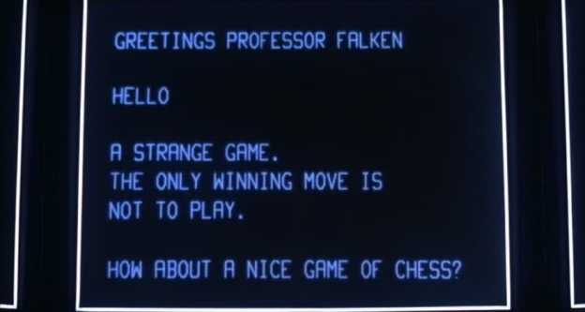
Notes:
Who remembers these?
One is from the 1960’s TV show Lost in Space. This was probably my first exposure to a robot that had cognitive thought and could converse with you.
The other is from the 1983 movie War Games starring Matthew Broderick. If you were at all technically inclined in the early 80’s, this movie was right in your wheelhouse.
After seeing War Games, I wondered how you could make a computer program intelligent enough to think. The challenge at that time was I was , that we didn’t have the computing resources and we didn’t have the data readily available to run the algorithms necessary to think like humans do.
Until now.

Slide 12
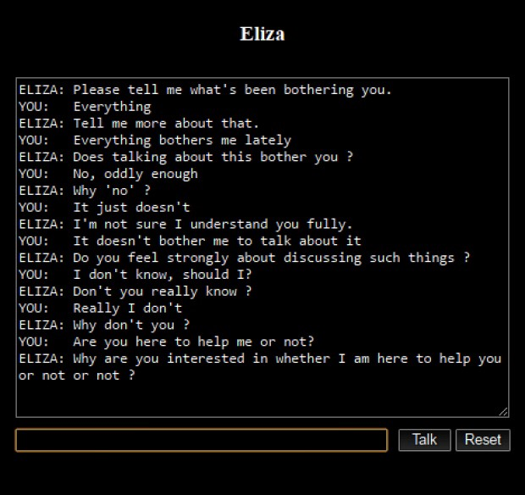
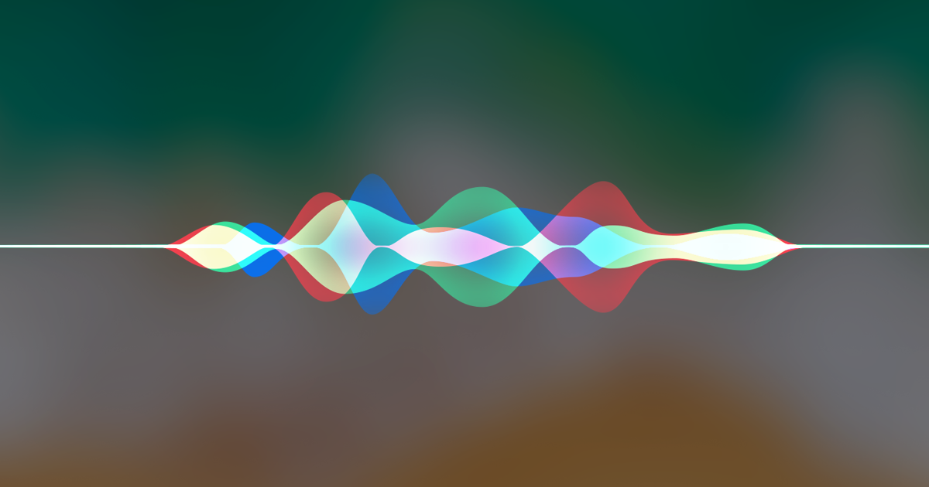



Chatbots are not new
50+ Years of conversations
ELIZA, circa 1966
Watson, 2006
Siri, Alexa, Cortana, Post 2010
Notes:
But, chatbots are really not new.
ELIZA is credited as being the first “chatterbot”. Created in 1966 and designed to mimic a conversation with a psychiatrist, it was more fun than really applicable. It was specifically programmed to look for key words and phrases and respond with specific questions. You can search for it and find several “emulators” and play around with it. It gets really annoying, very quickly.
A lot of these chatterbots, and now chatbots, were experimented with until 2006 when Watson burst onto the scenes in the Jeopardy challenge. A machine was competing with the reigning Jeopardy champions in a game that is most like a conversation. The question, phrased as an answer, is given and the answer must be phrased in the form of a question. This game covers many different topics and really requires understanding of human language and even subtleties like sarcasm and dual meanings. It also requires many years of historical knowledge. After being trained and provided enough data and computing power, Watson took on the champions and won handily.
Since then, this technology has become more real and available to businesses, coming even to consumer products like smartphones, cars, tvs and new in-home assistants like Google Home and Amazon Alexa. Businesses are using the cognitive chatbot technologies to create all new business models and ways of interacting with customers to improve customer satisfaction and increase revenues.

Slide 13
Business benefits of chatbots
Survey says…
39% of users expect a response on social media within an hour¹
More than 30% of call center tasks can be automated through chatbots¹
Chatbots are available 24/7
No turnover (unlike humans) reducing training and onboarding costs
Provides another channel for customer interactions
Changes can be made more easily than re-training humans
But, they are not the be-all, end-all
1 Survey conducted by TechSoup - http://forums.techsoup.org/cs/community/b/tsblog/archive/2017/08/14/ai-with-a-social-impact-the-top-5-reasons-why-nonprofits-should-explore-chatbots.aspx

Slide 14
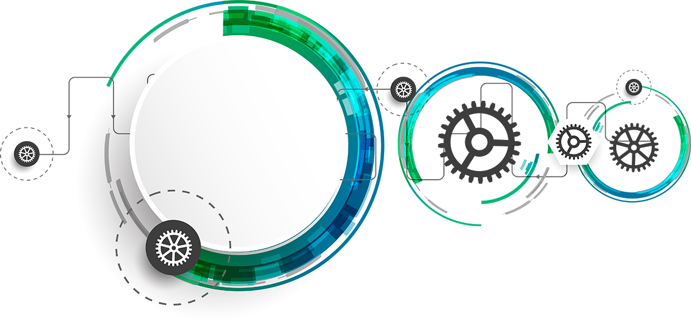
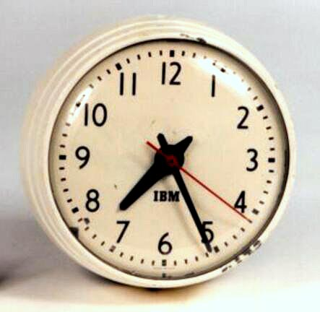
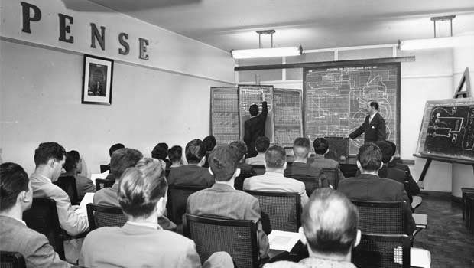
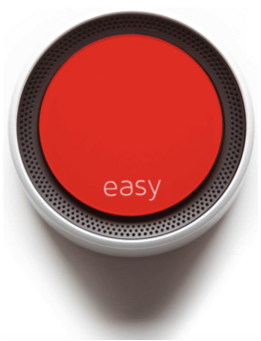
Business benefits of chatbots
39% of users expect a response on social media within an hour¹
More than 30% of call center tasks can be automated through chatbots¹
Chatbots are available 24/7
No turnover (unlike humans) reducing training and onboarding costs
Provides another channel for customer interactions
Changes can be made more easily than re-training humans
1 Survey conducted by TechSoup - http://forums.techsoup.org/cs/community/b/tsblog/archive/2017/08/14/ai-with-a-social-impact-the-top-5-reasons-why-nonprofits-should-explore-chatbots.aspx
Notes:
But, is this all hype? Does my business really need a chatbot, or two or more?
A survey conducted by TechSoup recently found that more than 30% of call center tasks can be automated through chatbots. That’s not to say that you can replace 30% of call center staff. This technology can, however, reduce the burden of answering some very common questions, freeing the customer service and support reps to spend time to resolve the more challenging problems.
The same survey found that 39% of users expect a response from you within 1 hour when they interact with you on social media. This can help automate responses to your customers, even if it is a simple, but intelligent and somewhat custom response, not just a ”we’ll be with you shortly” response.
Through working with companies, we have also observed that the use of chatbots can help in other ways. Chatbots don’t get tired and don’t need to work in shifts or require days off, they are 24 x 7. They don’t leave when they are unhappy and they can be retrained much quicker and cost effectively than humans. Again, this is not a recommendation to replace humans with chatbots, but as you gain knowledge of your business domain and as you gather more and more examples of customer interactions, the chatbot technology can learn from that and begin to augment the need for all new employees to know these things.
Have you been to H&R Block to do your taxes in the last year or two? There is a high degree of turnover with tax preparers each year because it is a very seasonal job. While tax preparers have to be trained in the tax code, it is nearly impossible to remember everything and things change annually. So, to help the tax preparers, H&R Block is using this technology to assist the tax preparers when they have questions. This helps even the most seasoned tax preparers and helps newbies come up to speed much faster.
Finally, companies are finding that they can create new channels for interacting with their customers and new ways to generate revenue. Staples has leveraged the concept of the easy button and created highly interactive, natural language interfaces for ordering business supplies. Users can simply talk, take photos and analyze past purchase history to simplify the process of managing business supplies.

Slide 15
Watson Conversation
Quickly build and deploy cognitive chatbots
Overview
Notes:
So, we’ve talked about the why you would want to use chatbots, now let’s start looking at some of the advantages of Watson Conversation Services and how to implement them.
Watson Conversation is the IBM Cloud service that can be used to power your chatbot.

Slide 16







Conversational interfaces
engage users across a range of channels and devices
Smart Home
Connected
Vehicles
Mobile
Laptop
Wearables
Robots
Gaming
Notes:
And chatbots can appear in multiple forms across a range of channels and devices including mobile, wearables, smart homes and connected vehicles as well as robots and gaming.

Slide 17



Our Primary Use Cases
Primary use cases
Customer Service
Provide customers with a fast, simple approach to resolve support related questions and problems.
Conversational Commerce
Provide guided buying experience for prospective customers to purchase goods and services through the mobile or messaging channel of their choice
Employee Productivity
Simplify access to common questions and tasks through Enterprise channels (e.g. Slack - e.g. Chatops, log support ticket, order office supplies, schedule meetings etc.
Notes:
We see this being used in all areas of business as well including customer service, commerce and employee productivity and HR

Slide 18




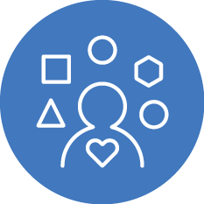

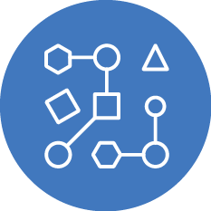
Watson Conversational assistants
Build once, deploy across multiple platforms
Create natural language interactions with your end-users, including Q&A and onboarding
Detect emotional states* and responds in appropriate ways
Create an omni-channel experience for better user engagement
Walk customers through business processes like application forms or resetting a password
Advanced Machine Learning capabilities
*Leveraging Watson Tone Analyzer
Notes:
In general I (Darrel) like the points this makes but does repeat some previous points. I think would be good to mention them as talking points on the previous slide.
Our customers and partners are also leveraging the integrations with other services, including

Slide 19
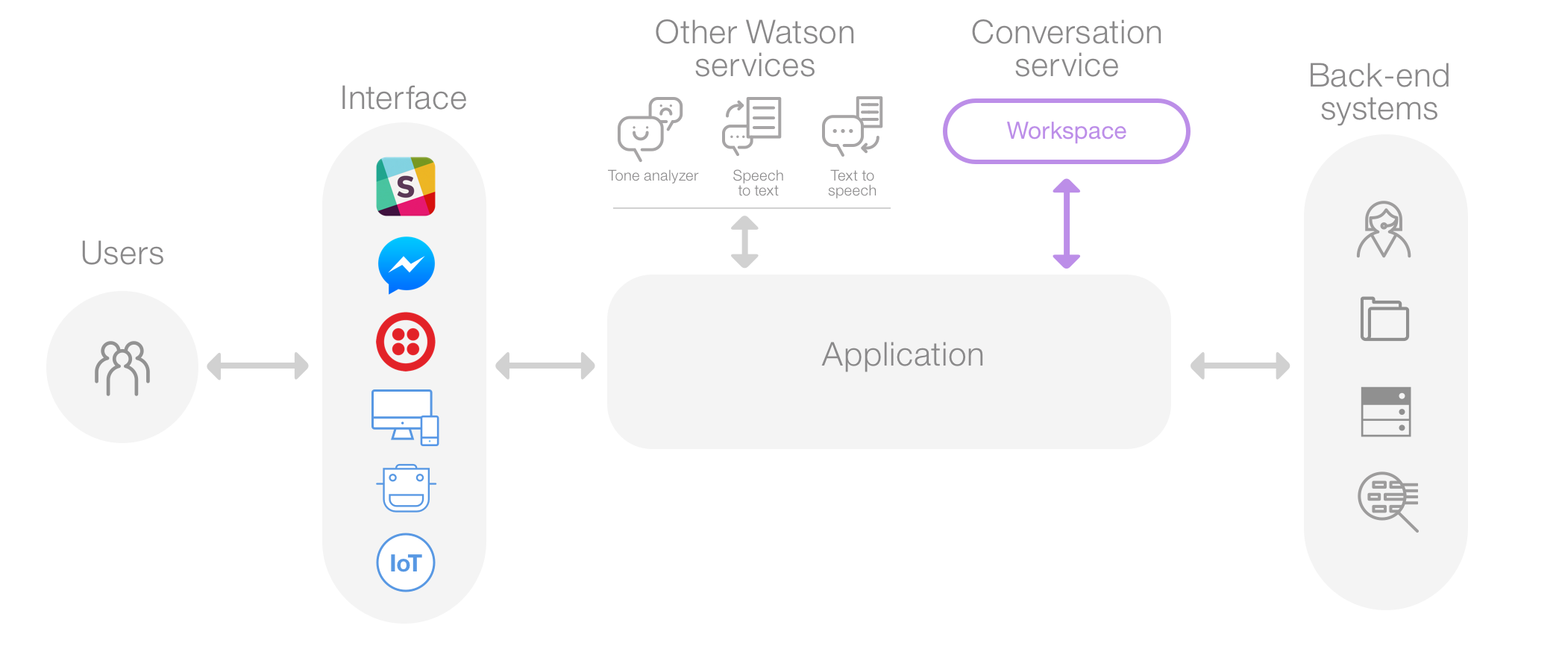
Works with other Watson API’s and services and applications
Build robust cognitive solutions
Notes:
The Watson Conversation service is designed to work with a wide variety of applications and services. UI’s can be through custom applications or leverage existing interfaces for providing chat services such as Slack, Facebook Messenger and others.
While it has Natural Language Understanding and Processing capabilities, it can be integrated with other services to enhance your application’s capabilities. For example, Text to Speech and Speech to Text can be used to take spoken words and translate them to something the machine can understand and convert the machine’s textual response to spoken word.
Tone Analyzer could be injected to determine if the user’s words signify anger, confusion or joy which could help to improve the overall conversation.
Finally, you may need to interact with other back end systems to look up data from systems of records, access weather data or device data.
Through the Watson Conversation service, you build robust cognitive solutions.

Slide 20
Why Watson Conversation service?
Simplified tooling – allows collaboration between business users and developers to build out conversational solutions, without needing to be an expert in Machine Learning.
Unified experience – integrates natural language understanding, dialog, content, and analytics into one tool for building and maintaining chatbots.
Premium/Dedicated Plans – provide enterprise-grade security and support, such as data isolation, end to end encryption, and support for non-regulated PII data.
Built-in analytics – provides insight into user interactions and understand best ways to optimize conversations (Recommends).
Watson’s cognitive toolbox – augment use cases with the broadest set of APIs and services that are in GA (e.g., Empathy, Speech, Discovery, Language, Vision, etc.)
Data Control – clients maintain control and ownership of their data
Deep industry expertise and partnerships – e.g., health, banking, automotive, retail
Notes:
Think this may be too salesy – I (Darrel) agree, comes across a bit salesy when mentioning plans, expertise, etc.

Slide 21







Customers using Watson Conversation
Notes:
Here are just a few of the brands using Watson Conversation service in their applications.

Slide 22
Hands-on Workshop
Building a Cognitive Chatbot with Watson Conversation and IBM Cloud
Notes:
So, now, we’re going to get into the hands-on workshop, but first…

Slide 23

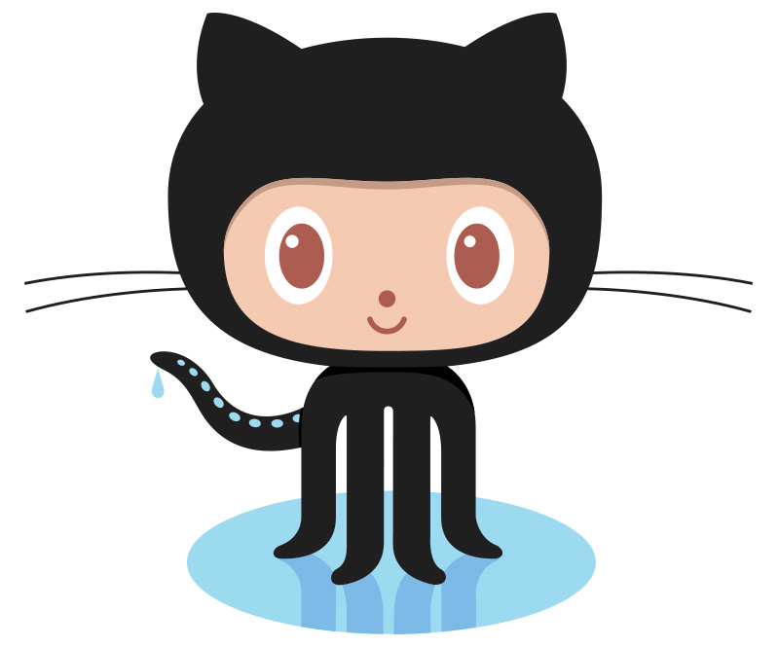
Workshop pre-requisites
What do you need to have
https://console.bluemix.net/
https://ibm.biz/wolfpack-cognitive-chatbot
Notes:
Let’s make sure you have some of the pre-requisites.
Do you have your IBM Cloud account, either a Cloud Lite, free-for-life account or a pay-as-you-go account
Access to our GitHub repository listed here

Slide 24

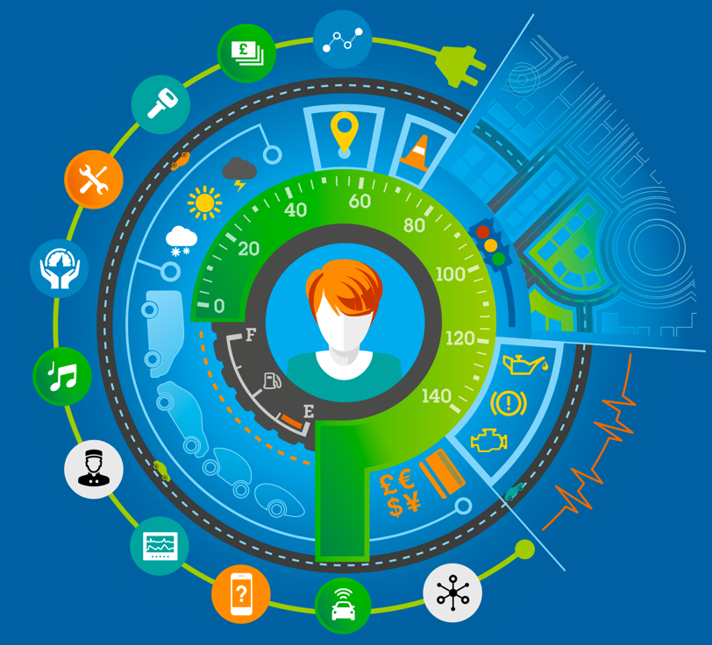

Workshop pre-requisites
What you need to know
Workspace
Intents
Entities
Dialogs
Notes:
And some things you’ll need to know as we get into the workshop. Watson conversation has 4 main concepts.
The main concept is that of a workspace. A workspace is a conversation application and is comprised of the remaining 3 concepts.
Intents are the first components. They are something the user is looking to get out of the conversation, such as pay a bill, turn the lights on, look up my account, etc.
Next you have entities which are objects that will be a player in the conversation, such as a light, account, time, place, etc.
The final concepts is the dialog which is the flow of the conversation and will refer to both intents and entities to guide the conversation.
Together, these make the overall conversation application which is known as the workspace.
Note: leaving as reference, feel free to delete below if not needed (Darrel)
A workspace is a conversation application and is comprised of 3 components
An intent is something the user is looking to get out of the conversation, such as pay a bill, turn the lights on, look up my account, etc.
An entity is something that is an object that will be a player in the conversation, such as a light, account, time, place, etc.
A dialog is the flow of the conversation and will refer to both intents and entities to guide the conversation

Slide 25
1
Create the Watson Conversation Service
2
Create a Watson Conversation Workspace
3
Create Intents
4
Build a dialog
5
Enhance the dialog
6
Add entities
7
Add some complexities
8
Deploy a chatbot web client application
Notes:
Now that you have an understanding of the basic constructs of Watson Conversation services, you have a background for the steps that we will be taking in the workshop.
The workshop will follow these steps:
Create an instance of the Watson Conversation service in the IBM Cloud
Create the Watson Conversation Workspace for our chatbot application
Create some intents and build an initial simple dialog to test
We’ll then enhance that dialog by adding some entities and some additional complexities to the dialog
Finally, we’ll deploy our conversation into a web application built with Node-RED or Node.js

Slide 26
Workshop
Notes:
But first, let’s take a 10 minute break

Slide 27
Next steps

Slide 28
Next steps
You are free to take the workshop materials with you and you have the sample in your IBM Cloud account
Enhance the workshop with other services
Tone Analyzer
Weather
IoT
Text to speech and speech to text
Think about the use cases for interactions that your customers and their customers might want to have with your solutions that could be automated with a chatbot
If you would like to brainstorm on some ideas, reach out to us via Direct Message on Twitter @IBMWolfPack
Notes:
So, now that you have completed the workshop, you have a running instance of your application in Node-RED or Node.js, you have the source code and you have a Watson Conversation service. Feel free to take these and extend them and build your own conversations for your applications.
If you’d like to reach out to us, we’ll be available after the workshop and we have our cards here if you’d like to take one.
You can find us on Twitter as well @IBMWolfPack. You can send us a Direct Message and follow us to see what else is coming up.

Slide 29
Notes:
Thank you and have a great day!

Slide 30
Be sure to take our survey.
http://bit.ly/WPLAustin013118
Notes:
Thank you and have a great day!
Austin 1/31/2018

Slide 31
Be sure to take our survey.
http://bit.ly/WPLDallas020718
Notes:
Thank you and have a great day!
Dallas 2/7/2018

